Slide 1

BUILDING
REPORTS
TYPES, STRUCTURE, TOPICS, & APA FORMAT
ER
By Tabby Self
August 24, 2022

Slide 2
Mock
Experimental report
Not Real
20 %
20 %
10 %
7
Final ER
ER
Building Stages
Presentation
ER

Slide 3
PURPOSE
Learn how to write, structure, and research academic literature, not conduct experiments.
Mock
Experimental report
20 %
20 %
10 %
7
Final ER
ER
Building Stages
Presentation
ER

Slide 4

STRUCTURE
REVIEW
essay TYPES
Compare & Contrast
Cause & Effect
Problem-Solution
Classification
Argument
Discussion
Definition
Process
Exemplification
Description
Title Page
Introduction
Main Body
Conclusion
Bibliography
(Smith, 2019)

Slide 5
STRUCTURE
reports
report TYPES
Experimental (Laboratory)
Business
Research
Case Study
Progress
Project
Design
Field
Technical
Preliminaries
Introduction
Main Body
Conclusion
End Matter
(Smith, 2019)

Slide 6
ESSAY
report
Argumentation based on secondary research
Well-ordered, continuous paragraphs, usually with no headings, subheadings or bullets
Methodical reading structure
Graphics unlikely
Secondary research only
Appendices unlikely
Data analyzation usually from primary research
Clearly defined sections often with headings, subheadings, and bullets
Quick reference structure
Graphics such as tables, graphs, and charts used frequently
Primary and secondary research
Appendices likely
ACADEMIC PAPERS
(Smith, 2019)

Slide 7
ESSAY
report
Argumentation based on secondary research
Well-ordered, continuous paragraphs, usually with no headings, subheadings or bullets
Methodical reading structure
Graphics unlikely
Secondary research only
Appendices unlikely
Data analyzation usually from primary research
Clearly defined sections often with headings, subheadings, and bullets
Quick reference structure
Graphics such as tables, graphs, and charts used frequently
Primary and secondary research
Appendices likely
ACADEMIC PAPERS
(Smith, 2019)

Slide 8
ESSAY
report
Argumentation based on secondary research
Well-ordered, continuous paragraphs, usually with no headings, subheadings or bullets
Methodical reading structure
Graphics unlikely
Secondary research only
Appendices unlikely
Data analyzation usually from primary research
Clearly defined sections often with headings, subheadings, and bullets
Quick reference structure
Graphics such as tables, graphs, and charts used frequently
Primary and secondary research
Appendices likely
ACADEMIC PAPERS
(Smith, 2019)

Slide 9
ESSAY
report
Argumentation based on secondary research
Well-ordered, continuous paragraphs, usually with no headings, subheadings or bullets
Methodical reading structure
Graphics unlikely
Secondary research only
Appendices unlikely
Data analyzation usually from primary research
Clearly defined sections often with headings, subheadings, and bullets
Quick reference structure
Graphics such as tables, graphs, and charts used frequently
Primary and secondary research
Appendices likely
ACADEMIC PAPERS
(Smith, 2019)

Slide 10
ESSAY
report
Argumentation based on secondary research
Well-ordered, continuous paragraphs, usually with no headings, subheadings or bullets
Methodical reading structure
Graphics unlikely
Secondary research only
Appendices unlikely
Data analyzation usually from primary research
Clearly defined sections often with headings, subheadings, and bullets
Quick reference structure
Graphics such as tables, graphs, and charts used frequently
Primary and secondary research
Appendices likely
ACADEMIC PAPERS
(Smith, 2019)

Slide 11
ESSAY
report
Argumentation based on secondary research
Well-ordered, continuous paragraphs, usually with no headings, subheadings or bullets
Methodical reading structure
Graphics unlikely
Secondary research only
Appendices unlikely
Data analyzation usually from primary research
Clearly defined sections often with headings, subheadings, and bullets
Quick reference structure
Graphics such as tables, graphs, and charts used frequently
Primary and secondary research
Appendices likely
ACADEMIC PAPERS
(Smith, 2019)

Slide 12



Can you build a house?
mock
Experimental REPORT
End Matter
STRUCTURE
Conclusion
Main Body
You will need
5 main components
Introduction
Preliminaries

Slide 13
foundation
mock
Experimental REPORT
PRELIMINARIES
Title Page
Abstract
Contents (optional)
Preliminaries

Slide 14
entrance
mock
Experimental REPORT
INTRODUCTION
Background
Theory
Aim
Introduction

Slide 15
rooms
mock
Experimental REPORT
MAIN BODY
2
3
Main Body
Materials & Method
Results
Discussion
1

Slide 16
attic
mock
Experimental REPORT
CONCLUSION
Conclusion
2
3
Findings Summary
Aim Achieved?
Recommendations
1

Slide 17
Roof
mock
Experimental REPORT
End Matter
END MATTER
2
3
References
Appendices
1

Slide 18

mock
Experimental report
Building Process
Step 1
Topic Proposal
Step 2
Annotated Bibliography
Step 3
Title Page & Introduction
Step 4
Step 5
Step 6
Step 7
Main Body
End Matter
Abstract
Rough Draft
20%

Slide 19
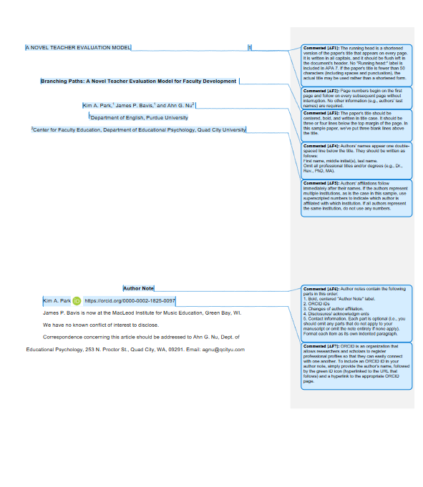

PURDUE ONLINE WRITING LAB
APA General Format, 7th ed.
SAMPLE PAPER
https://owl.purdue.edu/owl/research_and_citation/apa_style/apa_formatting_and_style_guide/general_format.html

Slide 20

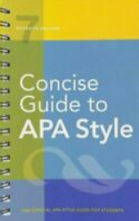
APA
7th edition
Details, details, details
Formatting Rules
ER Structure

Slide 21
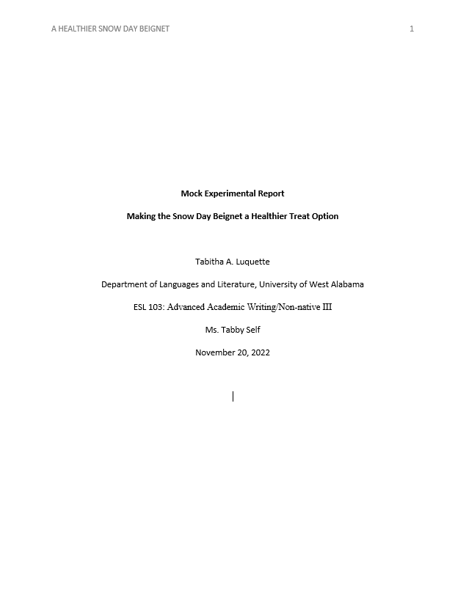
Formatting Rules
CHOOSING A TITLE
Direct
Precise
Informative
Explanatory
RUNNING HEADER
All caps
Shortened title
Only page number
GENERAL RULES
Same common font
Double space
1” margins
½” header margin
½” indentations
Title Page

Slide 22
Formatting Rules
TITLE INFORMATION
Title
Author (You), no title (Mr., Ms., Dr.)
Department, Institution
Class
Instructor name with proper title
Due date
Title Page

Slide 23
Formatting Rules
Extra Return
TITLE
Centered & bold
Title Page

Slide 24
Formatting Rules
Centered on page horizontally & vertically
Capitalize using title case
Title Page

Slide 25
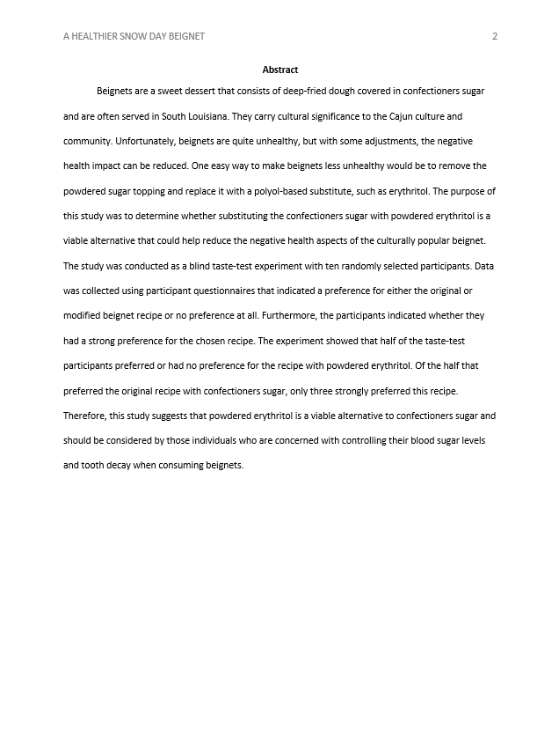
Formatting Rules
RUNNING HEADER
Continues on all pages
Abstract

Slide 26
Formatting Rules
No Extra Return
ABSTRACT
New page / page break
Centered & bold
Abstract

Slide 27
Formatting Rules
ABSTRACT INFORMATION
Written later in the semester
ER Stage 6
1 paragraph
200-word summary
Abstract

Slide 28
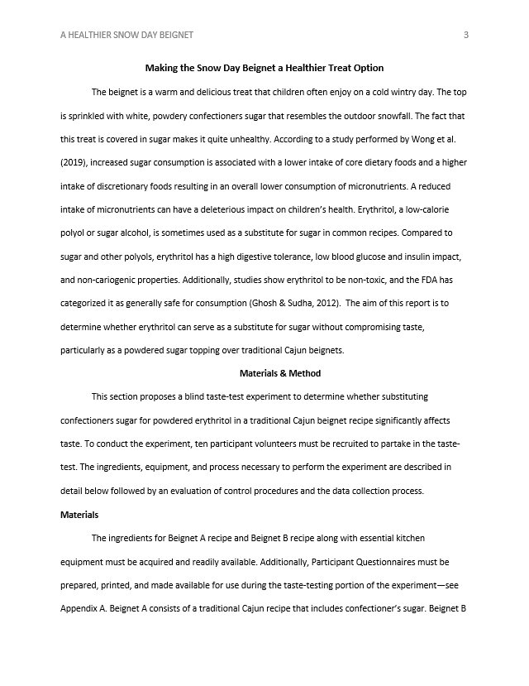
Formatting Rules
MARGINS
1” around text
½” header
All pages
Introduction

Slide 29
Formatting Rules
PARAGRAPGHS
½” indentation
No force justification
Introduction

Slide 30
Formatting Rules
No Extra Return
INTRODUCTION & TITLE
New page / page break
Centered & bold
Title case
Introduction

Slide 31
Formatting Rules
No Extra Returns
MAIN BODY & CONCLUSION
Written later in semester
ER Stages 4-5
200 words
Main Body & Conclusion

Slide 32
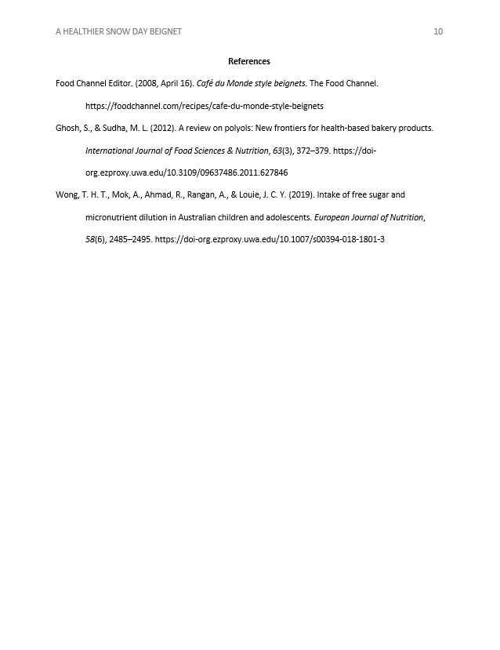
Formatting Rules
No Extra Return
REFERENCES
Centered & bold
New page / page break
REFERENCES

Slide 33
Formatting Rules
ENTRIES
Scholarly / peer reviewed articles
Alphabetical order
Hanging paragraph
½” indentation
REFERENCES

Slide 34
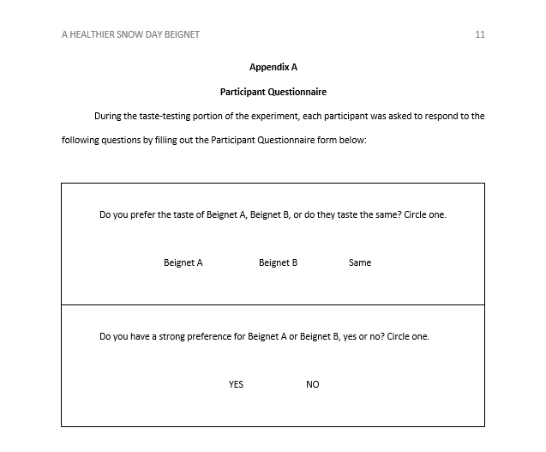
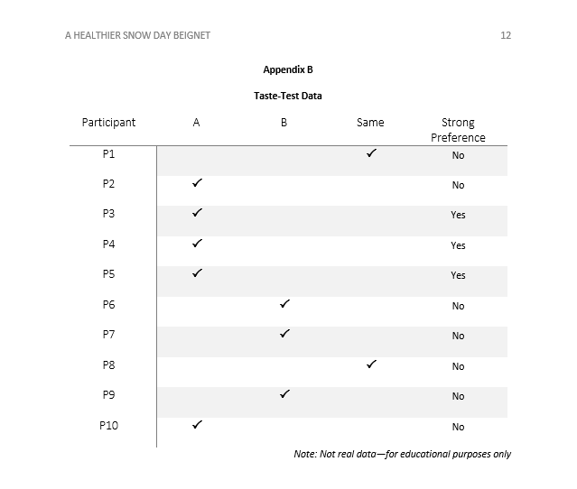
Formatting Rules
No Extra Returns
No Extra Returns
APPENDICES
Each on new page / page break
Labeled alphabetically (A, B, C…)
APPENDICES

Slide 35


How will substituting this ingredient make my dish healthier?
CHOOSING?
TOPIC
2 Favorite Home Dishes
Ingredients? Process?
Healthier?
Narrow your topic selection from 2 favorite home dishes to 1 that will best suit the Experimental Report.
Substitution?
Too complex/simple/healthy?
Considerations?
DISH

Slide 36




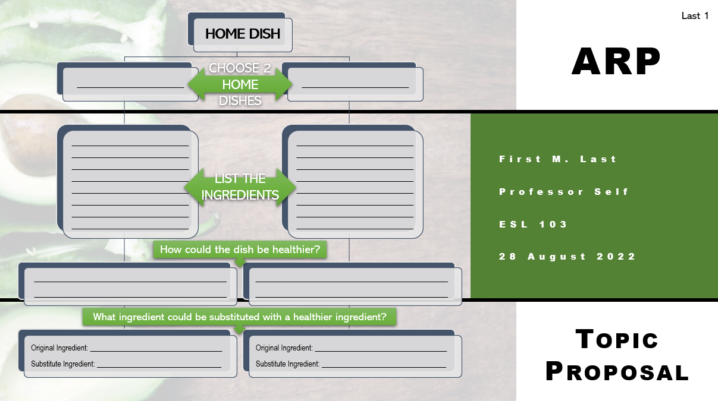
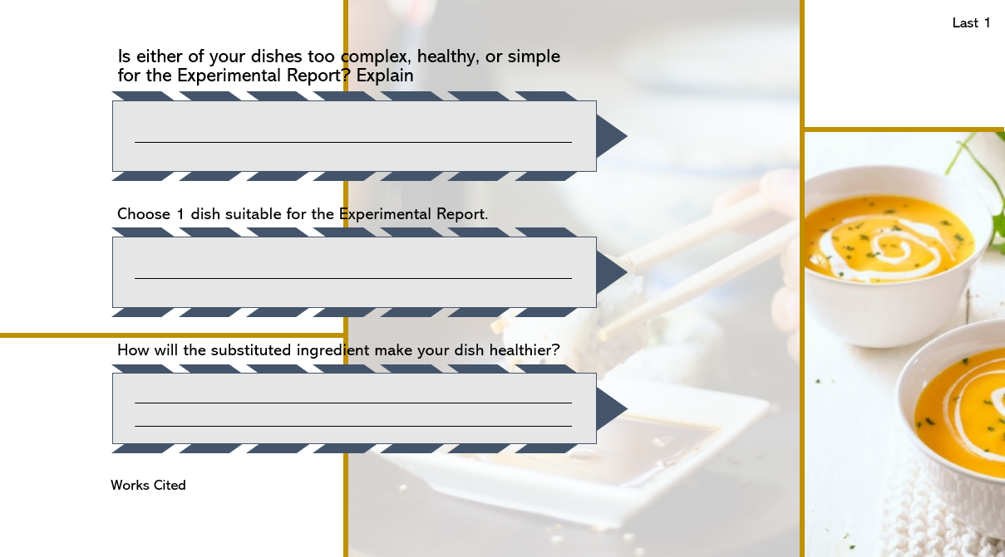
Come to class on Friday prepared to discuss your dish and how you plan to substitute an ingredient to make it healthier.
ER: TOPIC
PROPOSAL
Building
STAGE 1
DUE 8/28/2022

Slide 37




NEXT
Types of Reports
review
Structure & Building Process
APA Format
ER: Topic Proposal
RESOURCES
American Psychological Association. (2020). Concise guide to APA style: The official APA style guide for students (7th ed.).
Clements, J. (n.d.). Improve your primary pupils’ writing with the ‘marking funnel’ process. Teachwire. https://www.teachwire.net/news/improve-your-primary-pupils-writing-with-the-marking-funnel-process
Purdue Writing Lab. (n.d.). General format. Purdue Online Writing Lab. Retrieved January 18, 2022, from https://owl.purdue.edu/owl/research_and_citation/apa_style/apa_formatting_and_style_guide/general_format.html
Smith, S. (2019). Academic writing genres: Essays, reports & other genres. Evident Press.
Live Zoom on Friday
Dish experiment discussion
ER: Topic Proposal—Due 8/28/2022
Turnitin & Similarity Reports

